Slide 1

32555 – Fundamentals of Software Development

Slide 2
Welcome to 32555 – Fundamentals of Software Development
Your Teaching Team:
Dr. Yining Hu | Subject Coordinator
Yining is a Lecturer in Software Engineering. She works with many SMEs to develop software and AI solutions through student and research projects at UTS.
Contact: yining.hu@uts.edu.au
Dr. Xiaojie (Zoe) Lin | Tutor
Zoe is a full-stack software engineer with an interest in data analysis, specializing in JAVA, R, Python, JavaScript, PHP, Bash, and MATLAB; familiar with AWS.
Contact: Xiaojie.Lin@uts.edu.au
Dr. Farshid Keivanian | Tutor
Dr. Farshid Keivanian is an experienced university lecturer and researcher with a PhD in Information Technology. He has over 15 years of teaching experience across Australian institutions, specialising in software engineering, data science, AI, and cybersecurity.
Contact: Farshid.Keivanian@uts.edu.au
Yong Pov | Tutor
Yong is a full-stack software engineer with experience in React, JavaScript, TypeScript, Java, Python, SQL, and AI-assisted learning platforms.
Contact: Yong.Pov@uts.edu.au

Slide 3
Welcome to 32555 – Fundamentals of Software Development
Cmp1 # | Location | Time | Tutor
01 | CB11.B1.400 | Fri 16:00-18:00 | Xiaojie (Zoe) Lin
07 | CB11.B1.401 | Wed 10:00-12:00 | Farshid Keivanian
08 | CB11.B1.400 | Fri 12:00-14:00 | Yong Pov
09 | CB11.B1.103 | Wed 16:00-18:00 | Farshid Keivanian
10 | CB11.B1.401 | Wed 12:00-14:00 | Farshid Keivanian

Slide 4
Week 8 Outline
Lab 8
What is OOP?
Why use OOP?
Python Example 1: Creating a BankAccount Class (Objects = Data + Actions)
Java Example 1: Creating a BankAccount Class (Data + Actions Together)
Encapsulation
Python Example 2: Encapsulation in BankAccount (Hiding Data with Getters & Setters)
Java Example 2: Encapsulation in BankAccount (Using Private Fields and Getters/Setters)
Hands-On Activity 1 - Python: Try calling withdraw(2000) and see how the program prevents overdrawing.
Inheritance
Python Example 3: Inheritance with SavingsAccount (Child Reuses Parent Code)
Java Example 3: Inheritance with SavingsAccount (Child Reuses Parent Code)
Hands-On Activity 2 (Python): Create a CheckingAccount Subclass with Overdraft
Hands-On Activity 2 (Java): Create a CheckingAccount Subclass with Overdraft
Polymorphism
Python Example 4: Polymorphism with BankAccount (Same Method, Different Behaviour)

Slide 5
Week 8 Outline
Java Example 4: Polymorphism with BankAccount (Same Method, Different Behaviour)
Hands-On Activity 3 (Python): Adding a get_balance() Method (Encapsulation + Polymorphism)
Hands-On Activity 3 (Java): Adding a get_balance() Method (Encapsulation + Polymorphism)
Abstraction
Python Example 5: Abstraction with BankAccount (Using Abstract Class)
Java Example 5: Abstraction with BankAccount (Using Abstract Class)
Hands-On Activity 4 (Python): Creating a BusinessAccount Subclass (Abstraction + Polymorphism)
Python Example 6: Combining All OOP Concepts (Encapsulation, Inheritance, Polymorphism, Abstraction)
Java Example 6: Combining All OOP Concepts (Encapsulation, Inheritance, Polymorphism, Abstraction)
OOP Design Rules
Hands-On Activity 5 (Python): Adding add_interest() to SavingsAccount
The Menu Pattern
Python Example 7: Full OOP Program with Menu (Encapsulation, Inheritance, Abstraction, Polymorphism, Design Rules)
Java Example 7: Full OOP Program with Menu (Encapsulation, Inheritance, Abstraction, Polymorphism, Design Rules)
Hands-On Activity 6 (Python): Extend the Full OOP Program with Menu

Slide 6
Contents
Lab 8 exercises lab time: 120 minutes
Lab 8 has two objectives:
Primary: Implement the DeskBankApp [refer to Lab 7]
Secondary: Complete the practice exercises [1 and 2]
Complete the Lab 8 exercises using either Java or Python.
Recommended IDE for Java and Python: vscode

Slide 7
Lab 8
Case Study - continued: Create different login menus for the Manger and the Customers
Create a new Login class and use it as the entry point of the program.
The Login class should include:
A method to read a choice (L/A/X)
A help() method with explanations for all options (L – Log in as a customer.; A – Log in as the manager.; X – Exit.)
The main() method to create a bank object, a manager object, and start the program.
Notes:
Revised design:
- Bank stores the customer data, which shouldn't be directly exposed to the manager
- Bank provides methods relevant to managing customers
- removed the manager field from Bank
- Manager holds a references to the bank object, and manages customers using the methods provided by Bank
- Adding a login system (login.py) as the entry point of the program

Slide 8
Lab 8
Case Study - continued: Update the Bank class from Lab 7
The Bank class should have:
A constructor to add 3 customers and store them in the bank object (ensuring all customers have unique names)
A function to read a name
A procedure to add a new Customer to the customers list
A procedure to remove a Customer by name from the customers list
A procedure to view a Customer's account statement by name
A function to find a Customer by name
A procedure to view all Customers
A method for a customer to log into their own customer system
Design justification:
A Bank object should store its customers
The Bank class should contain methods to perform CRUD on customers
A manager object doesn’t have direct access to customers or customer CRUD operations; but holds a reference to the bank object and can manage customers using the methods provided by Bank.
Notes:
Revised design:
- Bank stores the customer data, which shouldn't be directly exposed to the manager
- Bank provides methods relevant to managing customers
- removed the manager field from Bank
- Manager holds a references to the bank object, and manages customers using the methods provided by Bank
- Adding a login system (login.py) as the entry point of the program

Slide 9
Lab 8
Case Study - continued: Update the Bank class from Lab 7
Replace the View Customers option in the Bank menu in Lab 7 with a Manager Login sub-menu, which includes the following operations:
A procedure to login as a Manager (new class) and use the Manager sub-system
A procedure to add a new Customer to the customers list
A procedure to remove a Customer by name from the customers list
A procedure to view a Customer's account statement by name
NOTE:
The Bank class should already have:
A function to find a Customer by name
A procedure to view all Customers
A function to read a name
A Bank menu and a help menu
The main() method
Notes:
Revised design:
- Bank stores the customer data, which shouldn't be directly exposed to the manager
- Bank provides methods relevant to managing customers
- removed the manager field from Bank
- Manager holds a references to the bank object, and manages customers using the methods provided by Bank
- Adding a login system (login.py) as the entry point of the program

Slide 10
Lab 8
Case Study - continued: Develop the Manager class
The Manager class has a field "name"
The Manager constructor initializes the field "name" to “John Smith”
The Manager has a method to view all customers [HINT: use the view function in Bank]
The Manager has a method to add a customer [HINT: use the add function in Bank]
The Manager has a method to remove a customer by name [HINT: use the remove function in Bank]
The Manager has a method to view a particular customer's statement by name [HINT: use the show function in Bank]
The Manager has the admin sub-system menu with the following options:
  (a) – add a customer
  (r) – remove a customer
(v) – view all customers
(s) – show a customer's statement by name

Slide 11
Lab 8
Case Study - continued: Sample I/O
Create Accounts for Customer: Lin
Initial Savings balance $1000
Initial Loan balance $2000
Create Accounts for Customer: Paul
Initial Savings balance $2000
Initial Loan balance $3000
Create Accounts for Customer: Alex
Initial Savings balance $4000
Initial Loan balance $5000
Bank menu: 30/08/2023 - 13:45:48
Customer menu (L/A/X): A
John Smith admin menu: 30/08/2023 - 13:45:48
Manager menu (a/r/s/v/x): s
Enter Customer Name: Paul
Paul --> Savings account has $2000.00 | Loan account has $3000.00
Manager menu (a/r/s/v/x): v
Lin --> Savings account has $1000.00 | Loan account has $2000.00
Paul --> Savings account has $2000.00 | Loan account has $3000.00
Alex --> Savings account has $4000.00 | Loan account has $5000.00
Manager menu (a/r/s/v/x): r
Enter Customer Name: Paul
Manager menu (a/r/s/v/x): v
Lin --> Savings account has $1000.00 | Loan account has $2000.00
Alex --> Savings account has $4000.00 | Loan account has $5000.00

Slide 12
Lab 8
Case Study - continued: Sample I/O
Manager menu (a/r/s/v/x): a
Enter Customer Name: Lara
Initial Savings balance $2500
Initial Loan balance $3400
Manager menu (a/r/s/v/x): v
Lin --> Savings account has $1000.00 | Loan account has $2000.00
Alex --> Savings account has $4000.00 | Loan account has $5000.00
Lara --> Savings account has $2500.00 | Loan account has $3400.00
Manager menu (a/r/s/v/x): x
Back to Bank menu
Customer menu (L/A/X): X
Done

Slide 13
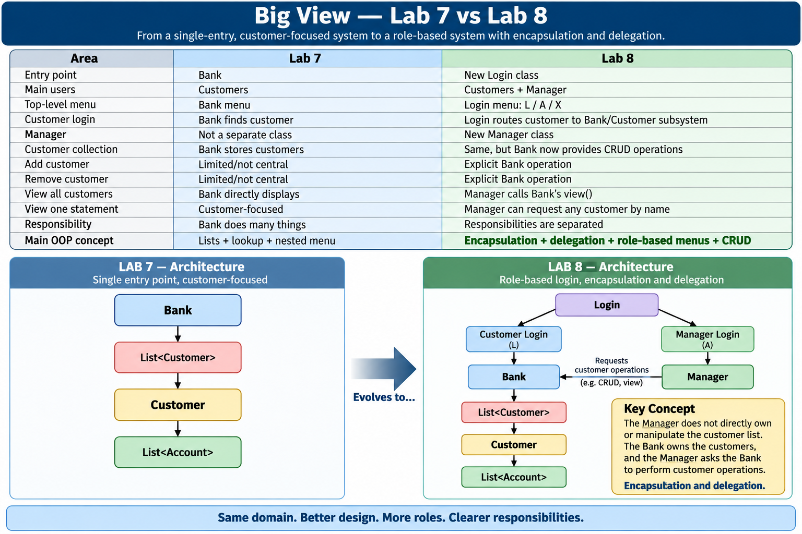
Big View – Lab 8 vs Lab 7

Slide 14
Lab 8 — DeskBankApp Sixth Implementation
Step 1 — Decide which classes we need
We now need:
Login
Bank
Manager
Customer
Account

Slide 15
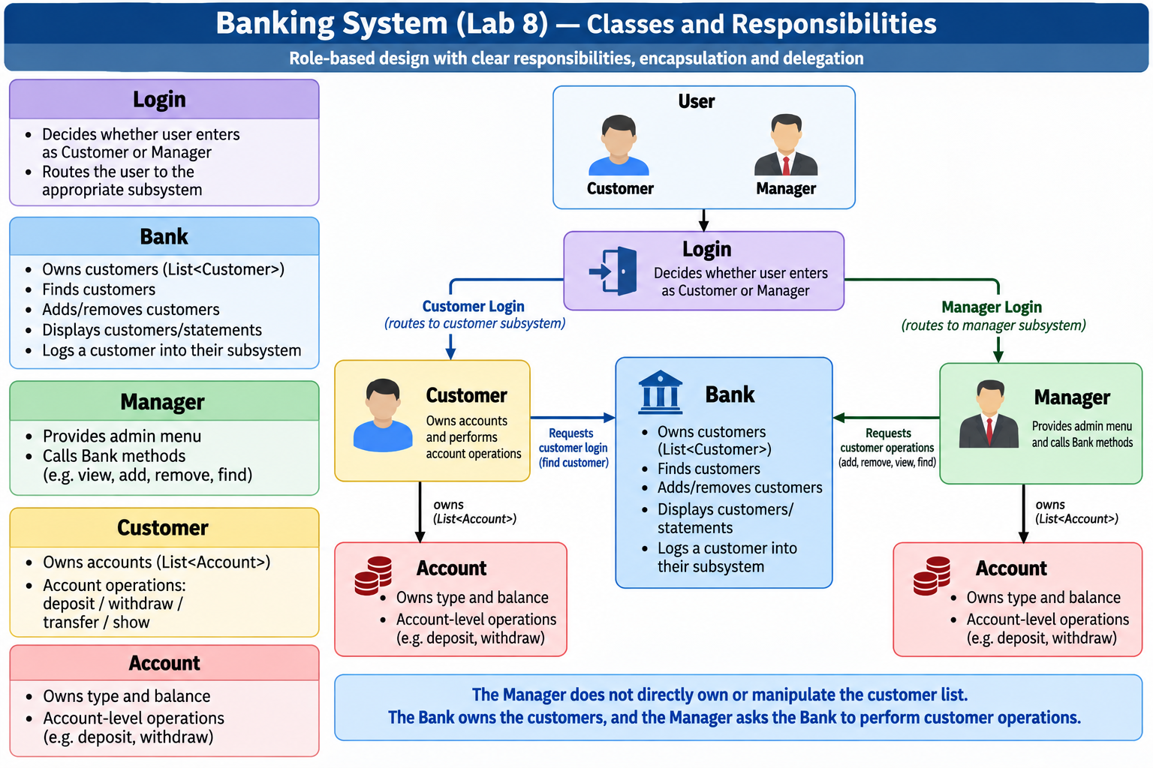
Lab 8 — DeskBankApp Sixth Implementation

Slide 16
Step 2 — Keep Account from Lab 7
Lab 8 does not fundamentally change the Account class, so students should reuse it rather than rewrite the whole application.
Python — Account
class Account:
def __init__(self, account_type):
self.type = account_type
self.balance = float(input(f"Initial {self.type} balance $"))
def matches(self, account_type):
return (self.type.lower() == account_type.lower())
def deposit(self, amount):
self.balance += amount
def has(self, amount):
return self.balance >= amount
def withdraw(self, amount):
if not self.has(amount):
raise ValueError("Insufficient funds")
self.balance -= amount
def transfer(self, amount, other_account):
if not self.has(amount):
raise ValueError("Insufficient funds")
self.withdraw(amount)
# Following the Lab 7/8 loan-payment example
other_account.withdraw(amount)
def __str__(self):
return (f"{self.type} account has "f"${self.balance:,.2f}")

Slide 17
Step 3 — Keep Customer from Lab 7
The Customer still has:
name
accounts
and its own customer menu.
Python — Customer outline
class Customer:
def __init__(self, name):
self.name = name
print(f"Create Accounts for Customer: "f"{self.name}")
self.accounts = [Account("Savings"), Account("Loan")]

Slide 18
Step 4 — Add customer name matching
Bank will need to find customers by name.
def matches(self, name):
return (self.name.lower() == name.lower())
This means:
customer.matches("Paul")
returns True if the customer's name is Paul.

Slide 19
Step 5 — Find an account by type
def account(self, account_type):
for account in self.accounts:
if account.matches(account_type):
return account
return None
Simple meaning:
Search the account list and return the requested account.

Slide 20
Step 6 — Customer banking operations
def deposit(self):
amount = float(input("Amount to deposit: $"))
self.account("Savings").deposit(amount)
Withdrawal:
def withdraw(self):
amount = float(input("Amount to withdraw: $"))
try:
self.account("Savings").withdraw(amount)
except ValueError as error:
print(error)
Transfer:
def transfer(self):
amount = float(input("Amount to transfer: $"))
savings = self.account("Savings")
loan = self.account("Loan")
try:
savings.transfer(amount, loan)
except ValueError as error:
print(error)

Slide 21
Step 7 — Customer statement
from datetime import datetime
Then:
def show(self):
now = datetime.now().strftime("%d/%m/%Y - %H:%M:%S")
print(f"{self.name} bank statement: "f"{now}")
for account in self.accounts:
print(account)

Slide 22
Step 8 — Customer menu
def menu(self):
while True:
choice = input("Customer menu " "(d/w/t/s/x): ").lower()
if choice == "d":
self.deposit()
elif choice == "w":
self.withdraw()
elif choice == "t":
self.transfer()
elif choice == "s":
self.show()
elif choice == "x":
print("Back to Bank menu")
break

Slide 23
Completed Python Customer
from datetime import datetime
class Customer:
def __init__(self, name):
self.name = name
print(f"Create Accounts for Customer: "f"{self.name}")
self.accounts = [Account("Savings"), Account("Loan")]
def matches(self, name):
return (self.name.lower() == name.lower())
def account(self, account_type):
for account in self.accounts:
if account.matches(account_type):
return account
return None
def deposit(self):
amount = float(input("Amount to deposit: $"))
self.account("Savings").deposit(amount)
def withdraw(self):
amount = float(input("Amount to withdraw: $"))
try:
self.account("Savings").withdraw(amount)
except ValueError as error:
print(error)
def transfer(self):
amount = float(input("Amount to transfer: $"))
savings = self.account("Savings")
loan = self.account("Loan")
try:
savings.transfer(amount, loan)
except ValueError as error:
print(error)

Slide 24
def show(self):
now = datetime.now().strftime("%d/%m/%Y - %H:%M:%S")
print(f"{self.name} bank statement: "f"{now}")
for account in self.accounts:
print(account)
def summary(self):
savings = self.account("Savings")
loan = self.account("Loan")
return (f"{self.name:<8} --> "f"{savings} | {loan}")
def menu(self):
while True:
choice = input("Customer menu ""(d/w/t/s/x): ").lower()
if choice == "d":
self.deposit()
elif choice == "w":
self.withdraw()
elif choice == "t":
self.transfer()
elif choice == "s":
self.show()
elif choice == "x":
print("Back to Bank menu")
break

Slide 25
Step 9 — Update Bank: store customers
This is where Lab 8 becomes more interesting.
class Bank:
def __init__(self):
self.customers = []
The requirement says the constructor adds three customers.
We also need to ensure names are unique.

Slide 26
Step 10 — Find a customer
Write this first because several other methods will reuse it.
def find(self, name):
for customer in self.customers:
if customer.matches(name):
return customer
return None
This gives us:
Customer object → if found
None → if not found

Slide 27
Step 11 — Read a name
def read_name(self):
return input("Enter Customer Name: ").strip()

Slide 28
Step 12 — Add a customer
We must prevent duplicate names.
def add(self):
name = self.read_name()
if self.find(name) is not None:
print("Customer already exists")
return
self.customers.append(Customer(name))
This is the Create part of CRUD.

Slide 29
Step 13 — Remove a customer
def remove(self):
name = self.read_name()
customer = self.find(name)
if customer is None:
print("Customer does not exist")
return
self.customers.remove(customer)
This is the Delete part of CRUD.

Slide 30
Step 14 — View one customer's statement
def show(self):
name = self.read_name()
customer = self.find(name)
if customer is None:
print("Customer does not exist")
return
print(customer.summary())
This matches the sample:
Paul --> Savings account has $2000.00 | Loan account has $3000.00

Slide 31
Step 15 — View all customers
def view(self):
for customer in self.customers:
print(customer.summary())

Slide 32
Step 16 — Customer login
def customer_login(self):
name = self.read_name()
customer = self.find(name)
if customer is None:
print("Customer does not exist")
return
customer.menu()

Slide 33
Step 17 — Add three initial customers
The sample uses:
Lin
Paul
Alex
The constructor can initialize them.
def __init__(self):
self.customers = []
for name in ["Lin", "Paul","Alex"]:
self.customers.append(Customer(name))
Because the names are predefined and different, they are unique.
For a more general version, we would check with find() before adding.

Slide 34
Completed Python Bank
class Bank:
def __init__(self):
self.customers = []
for name in [
"Lin",
"Paul",
"Alex"
]:
self.customers.append(
Customer(name)
)
def read_name(self):
return input(
"Enter Customer Name: "
).strip()
def find(self, name):
for customer in self.customers:
if customer.matches(name):
return customer
return None
def add(self):
name = self.read_name()

Slide 35
if self.find(name) is not None:
print(
"Customer already exists"
)
return
self.customers.append(
Customer(name)
)
def remove(self):
name = self.read_name()
customer = self.find(name)
if customer is None:
print(
"Customer does not exist"
)
return

Slide 36
self.customers.remove(
customer
)
def show(self):
name = self.read_name()
customer = self.find(name)
if customer is None:
print(
"Customer does not exist"
)
return
print(
customer.summary()
)

Slide 37
def view(self):
for customer in self.customers:
print(
customer.summary()
)
def customer_login(self):
name = self.read_name()
customer = self.find(name)
if customer is None:
print(
"Customer does not exist"
)
return
customer.menu()

Slide 38
Step 18 — Create the Manager class
Manager has:
name = "John Smith"
and a reference to the Bank.
This is important:
Manager
↓ holds reference
Bank
↓ owns
Customers
The Manager does not maintain another customer list.

Slide 39
Step 19 — Manager constructor
class Manager:
def __init__(self, bank):
self.name = "John Smith"
self.bank = bank

Slide 40
Step 20 — Manager view()
Instead of writing duplicate code:
def view(self):
self.bank.view()
This is delegation.
Manager asks Bank to do the work.

Slide 41
Step 21 — Manager add()
def add(self):
self.bank.add()
Step 22 — Manager remove()
def remove(self):
self.bank.remove()

Slide 42
Step 23 — Manager show one customer
def show(self):
self.bank.show()
Step 24 — Manager menu
Required options:
a = add
r = remove
s = show one customer
v = view all
x = exit

Slide 43
Completed Python Manager
from datetime import datetime
class Manager:
def __init__(self, bank):
self.name = "John Smith"
self.bank = bank
def view(self):
self.bank.view()
def add(self):
self.bank.add()
def remove(self):
self.bank.remove()
def show(self):

Slide 44
self.bank.show()
def menu(self):
now = datetime.now().strftime(
"%d/%m/%Y - %H:%M:%S"
)
print(
f"{self.name} admin menu: "
f"{now}"
)
while True:
choice = input(
"Manager menu "
"(a/r/s/v/x): "
).lower()
if choice == "a":
self.add()
elif choice == "r":
self.remove()

Slide 45
elif choice == "s":
self.show()
elif choice == "v":
self.view()
elif choice == "x":
print(
"Back to Bank menu"
)
break

Slide 46
Step 25 — Create Login class
This is the major Lab 8 addition.
Login becomes the entry point.
Its menu is:
L = customer login
A = manager login
X = exit

Slide 47
Step 26 — read_choice()
def read_choice(self):
return input("Customer menu (L/A/X): ").upper()
The sample calls this "Customer menu", although conceptually it is really the Login/Bank entry menu.
I would explain that to students rather than changing the required output

Slide 48
Step 27 — help()
def help(self):
print("L = Log in as a customer")
print("A = Log in as the manager")
print("X = Exit")

Slide 49
Step 29 — main()
Requirement:
Create a Bank object, a Manager object, and start the program.
def main():
bank = Bank()
manager = Manager(bank)
login = Login(bank, manager)
login.menu()
Notice:
One Bank object
↓
same Bank reference
↓
Manager
This is important because the Manager must manage the same customer list, not a separate copy.

Slide 50
Completed Python Login
from datetime import datetime
class Login:
def __init__(
self,
bank,
manager):
self.bank = bank
self.manager = manager
def read_choice(self):
return input(
"Customer menu "
"(L/A/X): "
).upper()
def help(self):
print(
"L = Log in as a customer."
)

Slide 51
print(
"A = Log in as the manager."
)
print(
"X = Exit."
)
def menu(self):
now = datetime.now().strftime(
"%d/%m/%Y - %H:%M:%S"
)
print(
f"Bank menu: {now}"
)

Slide 52
while True:
choice = self.read_choice()
if choice == "L":
self.bank.customer_login()
elif choice == "A":
self.manager.menu()
elif choice == "X":
print("Done")
break

Slide 53
else:
self.help()
def main():
bank = Bank()
manager = Manager(
bank
)
login = Login(
bank,
manager
)
login.menu()
if __name__ == "__main__":
main()

Slide 54
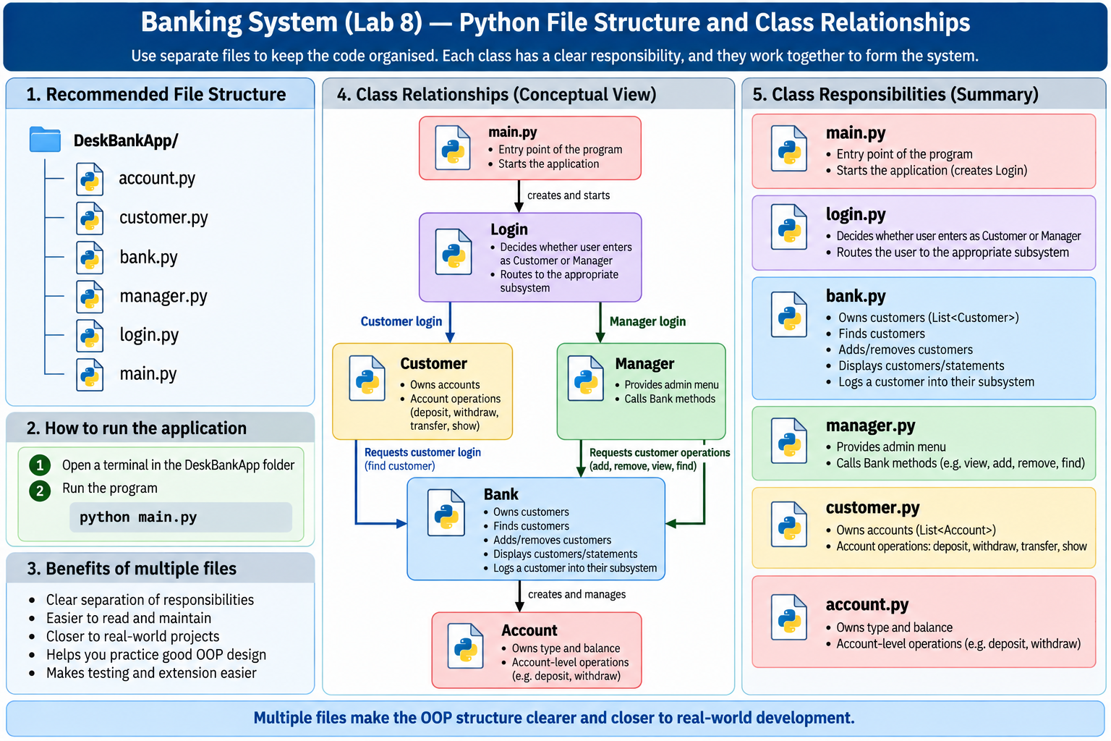

Slide 55
Java Version
For Java, I strongly recommend separate files:
Account.java
Customer.java
Bank.java
Manager.java
Login.java

Slide 56
Java Step 1 — Bank stores an ArrayList of Customers
private ArrayList<Customer> customers;
Constructor:
public Bank(Scanner input) {
customers =
new ArrayList<>();
customers.add(
new Customer(
"Lin",
input
)
);
customers.add(
new Customer(
"Paul",
input
)
);
customers.add(
new Customer(
"Alex",
input
)
);
}

Slide 57
Java Step 2 — Read customer name
public String readName(
Scanner input) {
System.out.print(
"Enter Customer Name: "
);
return input.nextLine();
}

Slide 58
Java Step 3 — Find customer
public Customer find(
String name) {
for (
Customer customer
: customers
) {
if (
customer.matches(name)
) {
return customer;
}
}
return null;
}

Slide 59
Java Step 4 — Add customer
public void add(
Scanner input) {
String name =
readName(input);
if (find(name) != null) {
System.out.println(
"Customer already exists"
);
return;
}
customers.add(
new Customer(
name,
input
)
);
}

Slide 60
Java Step 5 — Remove customer
public void remove(
Scanner input) {
String name =
readName(input);
Customer customer =
find(name);
if (customer == null) {
System.out.println(
"Customer does not exist"
);
return;
}
customers.remove(
customer
);
}

Slide 61
Java Step 6 — View one customer
public void show(
Scanner input) {
String name =
readName(input);
Customer customer =
find(name);
if (customer == null) {
System.out.println(
"Customer does not exist"
);
return;
}
System.out.println(
customer.summary()
);
}

Slide 62
Java Step 7 — View all customers
public void view() {
for (
Customer customer
: customers
) {
System.out.println(
customer.summary()
);
}
}

Slide 63
Java Step 8 — Customer login
public void customerLogin(
Scanner input) {
String name =
readName(input);
Customer customer =
find(name);
if (customer == null) {
System.out.println("Customer does not exist");
return;
}
customer.menu(input);
}

Slide 64
Completed Java Bank.java
import java.util.ArrayList;
import java.util.Scanner;
public class Bank {
private ArrayList<Customer> customers;
public Bank(
Scanner input) {
customers =
new ArrayList<>();
customers.add(
new Customer(
"Lin",
input
)
);
customers.add(
new Customer(
"Paul",
input
)
);
customers.add(
new Customer(
"Alex",
input
)
);
}

Slide 65
public String readName(
Scanner input) {
System.out.print(
"Enter Customer Name: "
);
return input.nextLine();
}
public Customer find(
String name) {
for (
Customer customer
: customers
) {
if (
customer.matches(name)
) {

Slide 66
return customer;
}
}
return null;
}
public void add(
Scanner input) {
String name =
readName(input);
if (find(name) != null) {
System.out.println(
"Customer already exists"
);
return;
}

Slide 67
customers.add(
new Customer(
name,
input
)
);
}
public void remove(
Scanner input) {
String name =
readName(input);
Customer customer =
find(name);
if (customer == null) {
System.out.println(
"Customer does not exist"
);

Slide 68
return;
}
customers.remove(
customer
);
}
public void show(
Scanner input) {
String name =
readName(input);
Customer customer =
find(name);
if (customer == null) {
System.out.println(
"Customer does not exist"
);

Slide 69
return;
}
System.out.println(
customer.summary()
);
}
public void view() {
for (
Customer customer
: customers
) {
System.out.println(
customer.summary()
);
}
}

Slide 70
public void customerLogin(
Scanner input) {
String name =
readName(input);
Customer customer =
find(name);
if (customer == null) {
System.out.println(
"Customer does not exist"
);
return;
}
customer.menu(input);
}
}

Slide 71
Java Manager Class
Step 9 — Fields and constructor
private String name;
private Bank bank;
Constructor:
public Manager(
Bank bank) {
name =
"John Smith";
this.bank =
bank;
}

Slide 72
Step 10 — Delegate operations
public void view() {
bank.view();
}
public void add(
Scanner input) {
bank.add(input);
}
public void remove(
Scanner input) {
bank.remove(input);
}
public void show(
Scanner input) {
bank.show(input);
}

Slide 73
Completed Java Manager.java
import java.time.LocalDateTime;
import java.time.format.DateTimeFormatter;
import java.util.Scanner;
public class Manager {
private String name;
private Bank bank;
public Manager(
Bank bank) {
name =
"John Smith";
this.bank =
bank;
}
public void view() {
bank.view();
}

Slide 74
public void add(
Scanner input) {
bank.add(input);
}
public void remove(
Scanner input) {
bank.remove(input);
}
public void show(
Scanner input) {
bank.show(input);
}
public void menu(
Scanner input) {

Slide 75
DateTimeFormatter formatter =
DateTimeFormatter.ofPattern(
"dd/MM/yyyy - HH:mm:ss"
);
String now =
LocalDateTime.now()
.format(
formatter
);
System.out.println(
name
+ " admin menu: "
+ now
);

Slide 76
while (true) {
System.out.print(
"Manager menu "
+ "(a/r/s/v/x): "
);
String choice =
input.nextLine()
.toLowerCase();
switch (choice) {
case "a":
add(input);
break;

Slide 77
case "r":
remove(input);
break;
case "s":
show(input);
break;
case "v":
view();
break;

Slide 78
case "x":
System.out.println(
"Back to Bank menu"
);
return;
default:
System.out.println(
"a = add customer"
);
System.out.println(
"r = remove customer"
);

Slide 79
System.out.println(
"s = show statement"
);
System.out.println(
"v = view all"
);
System.out.println(
"x = exit"
);
}
}
}
}

Slide 80
Java Login Class
This is the new top-level controller.
Step 11 — Fields
private Bank bank;
private Manager manager;

Slide 81
Step 12 — Constructor
public Login(
Bank bank,
Manager manager) {
this.bank = bank;
this.manager = manager;
}

Slide 82
Step 13 — Read choice
public String readChoice(
Scanner input) {
System.out.print(
"Customer menu (L/A/X): "
);
return input.nextLine()
.toUpperCase();
}

Slide 83
Step 14 — Help
public void help() {
System.out.println("L = Log in as a customer.");
System.out.println("A = Log in as the manager.");
System.out.println(
"X = Exit."
);
}

Slide 84
Step 15 — Top-level menu
public void menu(
Scanner input) {
while (true) {
String choice =
readChoice(input);
switch (choice) {
case "L":
bank.customerLogin(
input
);
break;
case "A":
manager.menu(
input
);

Slide 85
break;
case "X":
System.out.println(
"Done"
);
return;
default:
help();
}
}
}

Slide 86
Completed Java Login.java
import java.time.LocalDateTime;
import java.time.format.DateTimeFormatter;
import java.util.Scanner;
public class Login {
private Bank bank;
private Manager manager;
public Login(
Bank bank,
Manager manager) {
this.bank =
bank;
this.manager =
manager;
}
public String readChoice(
Scanner input) {
System.out.print(
"Customer menu "
+ "(L/A/X): "
);

Slide 87
return input.nextLine()
.toUpperCase();
}
public void help() {
System.out.println(
"L = Log in as a customer."
);
System.out.println(
"A = Log in as the manager."
);
System.out.println(
"X = Exit."
);
}
public void menu(
Scanner input) {

Slide 88
DateTimeFormatter formatter =
DateTimeFormatter.ofPattern(
"dd/MM/yyyy - HH:mm:ss"
);
String now =
LocalDateTime.now()
.format(
formatter
);
System.out.println(
"Bank menu: "
+ now
);
while (true) {
String choice =
readChoice(input);
switch (choice) {
case "L":

Slide 89
bank.customerLogin(
input
);
break;
case "A":
manager.menu(
input
);
break;
case "X":
System.out.println(
"Done"
);
return;
default:

Slide 90
help();
}
}
}
public static void main(
String[] args) {
Scanner input =
new Scanner(System.in);
Bank bank =
new Bank(input);
input.nextLine();
Manager manager =
new Manager(bank);
Login login =
new Login(
bank,
manager
);

Slide 91
login.menu(input);
input.close();
}
}

Slide 92
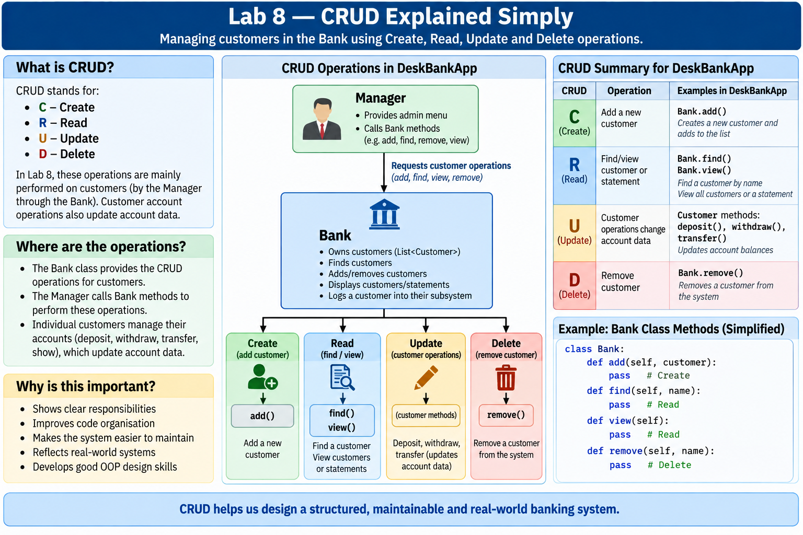

Slide 93
Lab 8 — Why Manager Does Not Directly Access Customers
This is one of the most important design points in the supplied material.
A poor design would be:
Manager → customers list
because now both Bank and Manager could manipulate the same data directly.
The Lab 8 design is:
Manager → calls Bank methods → Bank → owns customers
For example:
def remove(self):
self.bank.remove()

Slide 94
The Manager says:
Bank, please remove the requested customer.
The Bank decides how the customer list is actually changed.
This supports encapsulation.

Slide 95
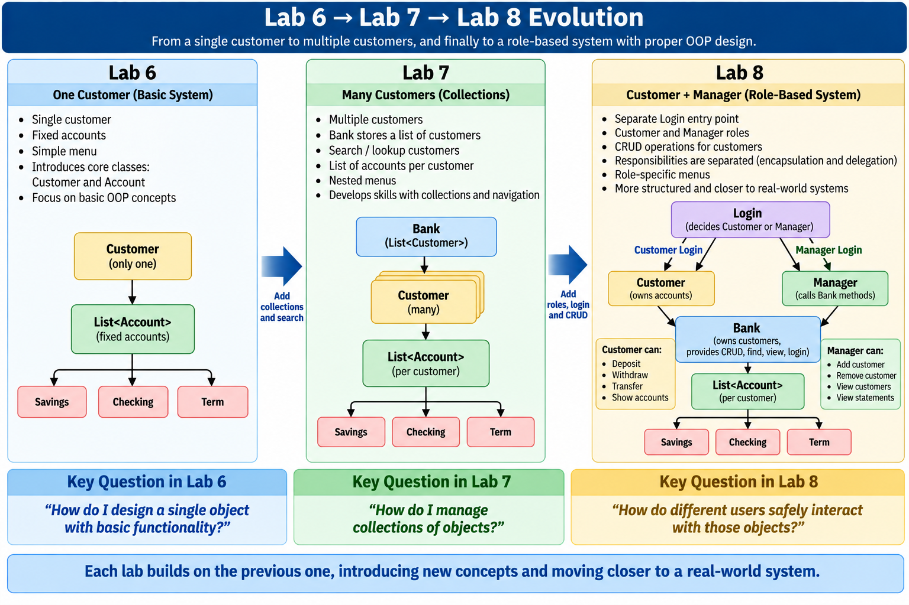

Slide 96
Lab 8 – Lab8Exercise1
Develop the program Lab8Exercise1 that contains the following 4 steps:
Step 1: Develop the Polygon class
Polygon has one field: type
Polygon has one constructor that initializes the field "type" from parameter
Polygon has an abstract method ‘area’ with no parameters and returns a double

Slide 97
Lab 8 – Lab8Exercise1
Step 2: Develop the class Square
Square is subclass of Polygon
Square has one field: side of type double
Square has one constructor that initializes the field side from parameter
Square overrides the method ‘area’ defined in Polygon to return the area of a square
Square overrides the __str__() method to return: “<type> area = <area>”
[type should be formatted using %-8s, and area should be formatted using %-6.2f]

Slide 98
Lab 8 – Lab8Exercise1
Step 3: Develop the class Triangle
Triangle is a subclass of Polygon
Triangle has two double fields: height and base
Triangle has one constructor that initializes these fields from parameters
Triangle overrides the method ‘area’ defined in Polygon to return the area of a triangle
Triangle overrides the __str__() method to return: “<type> area = <area>”
[type should be formatted using %-8s, and area should be formatted using %-6.2f]

Slide 99
Lab 8 – Lab8Exercise1
Step 4: Develop the class Shapes
Shapes has a field ‘shapes’ of type List which stores Polygon objects
Shapes has one constructor that initializes the field shapes
Shapes has a method ‘load_shapes’ to populate the List with the following objects:
- 2 Square objects with sides of 5 and 10
- 2 Triangle objects with height of 5 and base of 3, and height of 5 and base of 5
Shapes has a method ‘show’ that prints out information about all its Polygon objects
Run the program by creating an instance of Shapes and invoking the method ‘show’
Sample I/O:
Triangle area = 7.50
Triangle area = 12.50
Square area = 25.00
Square area = 100.00

Slide 100
Lab 8 Exercise 1 — Polygon, Square, Triangle, Shapes
Main learning goal
This exercise introduces:
abstract classes
inheritance
method overriding
polymorphism
lists of parent-class objects
The big idea is:
Polygon → Square
Triangle Both Square and Triangle are different shapes, but both can be treated as Polygon objects.

Slide 101
Step 1 — Create the abstract Polygon class
Python
Python uses the abc module for abstract classes.
Start with:
from abc import ABC, abstractmethod
Then create the class:
class Polygon(ABC):
def __init__(self, shape_type):
self.type = shape_type
@abstractmethod
def area(self):
pass

Slide 102
Simple explanation
ABC means:
This class is intended to be a parent/abstract class.
@abstractmethod means:
Every concrete subclass must provide its own area() method.
So we should not normally create:
Polygon("Shape")
directly.

Slide 103
Java
Java has built-in support for abstract classes.
public abstract class Polygon {
protected String type;
public Polygon(String type) {
this.type = type;
}
public abstract double area();
}
Explanation
abstract class Polygon
means we cannot directly create a normal Polygon object.
public abstract double area();
means subclasses must provide their own area calculation.

Slide 104
Step 2 — Create Square
Square:
inherits from Polygon
has one field: side
calculates square area
overrides string output
Python
class Square(Polygon):
def __init__(self, side):
super().__init__("Square")
self.side = side
What does super() do?
super().__init__("Square")
calls the constructor of the parent class.
So the inherited field:
type
becomes: Square

Slide 105
Step 2.1 — Override area()
def area(self):
return self.side * self.side
or:
return self.side ** 2

Slide 106
Step 2.2 — Override __str__()
The requirement says:
<type> area = <area>
with:
%-8s
%-6.2f
A close Python equivalent is:
def __str__(self):
return (f"{self.type:<8} " f"area = {self.area():<6.2f}")
Example:
Square area = 25.00

Slide 107
Completed Python Square
class Square(Polygon):
def __init__(self, side):
super().__init__("Square")
self.side = side
def area(self):
return self.side ** 2
def __str__(self):
return (f"{self.type:<8} "f"area = {self.area():<6.2f}")

Slide 108
Java Square
public class Square extends Polygon {
private double side;
public Square(double side) {
super("Square");
this.side = side;
}
@Override
public double area() {
return side * side;
}
@Override
public String toString() {
return String.format(
"%-8s area = %-6.2f",
type,
area()
);
}
}

Slide 109

Step 3 — Create Triangle
Triangle:
inherits from Polygon
has height
has base
calculates triangle area
overrides string output
Formula:
$$Area=\frac{1}{2}×base×height$$

Slide 110
Python
class Triangle(Polygon):
def __init__(self, height, base):
super().__init__("Triangle")
self.height = height
self.base = base
Area:
def area(self):
return 0.5 * self.base * self.height
String:
def __str__(self):
return (
f"{self.type:<8} "
f"area = {self.area():<6.2f}"
)

Slide 111
Completed Python Triangle
class Triangle(Polygon):
def __init__(self, height, base):
super().__init__("Triangle")
self.height = height
self.base = base
def area(self):
return (
0.5
* self.base
* self.height
)
def __str__(self):
return (
f"{self.type:<8} "
f"area = {self.area():<6.2f}"
)

Slide 112
Java Triangle
public class Triangle extends Polygon {
private double height;
private double base;
public Triangle(
double height,
double base) {
super("Triangle");
this.height = height;
this.base = base;
}
@Override
public double area() {
return 0.5
* base
* height;
}
@Override
public String toString() {
return String.format(
"%-8s area = %-6.2f",
type,
area()
);
}
}

Slide 113
Step 4 — Create Shapes class
Shapes stores a list of Polygon objects.
This is important.
The list can contain:
Square
Triangle
Square
Triangle
because all of them are subclasses of Polygon

Slide 114
Python
Start:
class Shapes:
def __init__(self):
self.shapes = []
self.load_shapes()

Slide 115
Step 4.1 — Load the shapes
Requirement:
Square side 5
Square side 10
Triangle height 5, base 3
Triangle height 5, base 5
To match the sample output order, load triangles first, then squares:
def load_shapes(self):
self.shapes.append(Triangle(5, 3))
self.shapes.append(Triangle(5, 5))
self.shapes.append(Square(5))
self.shapes.append(Square(10))

Slide 116
Step 4.2 — Show all shapes
def show(self):
for shape in self.shapes:
print(shape)
This is polymorphism.
Each object responds to:
print(shape)
using its own overridden __str__().

Slide 117
Completed Python — Lab8Exercise1
from abc import ABC, abstractmethod
class Polygon(ABC):
def __init__(self, shape_type):
self.type = shape_type
@abstractmethod
def area(self):
pass
class Square(Polygon):
def __init__(self, side):
super().__init__("Square")
self.side = side

Slide 118
def area(self):
return self.side ** 2
def __str__(self):
return (
f"{self.type:<8} "
f"area = {self.area():<6.2f}"
)
class Triangle(Polygon):
def __init__(
self,
height,
base):

Slide 119
super().__init__("Triangle")
self.height = height
self.base = base
def area(self):
return (
0.5
* self.base
* self.height
)
def __str__(self):
return (
f"{self.type:<8} "
f"area = {self.area():<6.2f}"
)

Slide 120
class Shapes:
def __init__(self):
self.shapes = []
self.load_shapes()
def load_shapes(self):
self.shapes.append(
Triangle(5, 3)
)
self.shapes.append(
Triangle(5, 5)
)

Slide 121
self.shapes.append(
Square(5)
)
self.shapes.append(
Square(10)
)
def show(self):
for shape in self.shapes:
print(shape)
def main():
shapes = Shapes()
shapes.show()
if __name__ == "__main__":
main()

Slide 122
Completed Java — Lab8Exercise1
I recommend four files:
Polygon.java
Square.java
Triangle.java
Shapes.java

Slide 123
Polygon.java
public abstract class Polygon {
protected String type;
public Polygon(String type) {
this.type = type;
}
public abstract double area();
}

Slide 124
Square.java
public class Square extends Polygon {
private double side;
public Square(double side) {
super("Square");
this.side = side;
}
@Override
public double area() {
return side * side;
}

Slide 125
@Override
public String toString() {
return String.format(
"%-8s area = %-6.2f",
type,
area()
);
}
}

Slide 126
Triangle.java
public class Triangle extends Polygon {
private double height;
private double base;
public Triangle(
double height,
double base) {
super("Triangle");
this.height = height;
this.base = base;
}

Slide 127
@Override
public double area() {
return 0.5
* base
* height;
}
@Override
public String toString() {
return String.format(
"%-8s area = %-6.2f",
type,
area()
);
}
}

Slide 128
Shapes.java
import java.util.ArrayList;
public class Shapes {
private ArrayList<Polygon> shapes;
public Shapes() {
shapes =
new ArrayList<>();
loadShapes();
}
public void loadShapes() {
shapes.add(
new Triangle(5, 3)
);
shapes.add(
new Triangle(5, 5)
);

Slide 129
shapes.add(
new Square(5)
);
shapes.add(
new Square(10)
);
}
public void show() {
for (
Polygon shape
: shapes
) {
System.out.println(
shape
);
}
}

Slide 130
public static void main(
String[] args) {
Shapes shapes =
new Shapes();
shapes.show();
}
}

Slide 131
Lab 8 – Lab8Exercise2 (Java)
Develop the program Lab8Exercise2 following the below 4 steps:
Step 1: Develop an abstract class Animal
Animal has two fields: type (of String type) and position (of int type)
Animal has a constructor that initializes the type and position from parameters
Animal has an abstract procedure walk
Animal has a show() method that displays the animal’s type and current position in the following format: “<type> is at position <position>”

Slide 132
Lab 8 – Lab8Exercise2
Step 2: Develop two classes: Dog and Cat
Dog and Cat are subclasses of Animal
Define a constructor in each class that uses the superclass Animal's constructor and initializes the position to zero and the type to the type of the object.
Override the method walk() to enable:
- A Dog to move by 4 (every time the walk() method is called)
- A Cat to move by 2 (every time the walk() method is called)

Slide 133
Lab 8 – Lab8Exercise2
Step 3: Develop the Farm class
Farm has a field ‘animals’ of List type to store animal objects
Farm has a constructor that initializes the List animals using the populate() method
The procedure ‘populate()’ initializes the List animals with one dog object and one cat object
Farm has a procedure ‘walk()’ that moves all animal objects in Farm.
Farm has a procedure ‘show()’ that shows the positions of all animal objects in Farm.

Slide 134
Lab 8 – Lab8Exercise2
Step 4: complete the Farm class with a CLI system menu() method. A sample I/O is provided below:
                Choice (w/s/x): w
                Walking the animals …
                Choice (w/s/x): s
                <animal-type> is at position <position>
                Choice (w/s/x): x
                Goodbye!
                Define the main() method that uses the menu() and starts the program

Slide 135

Happy Learning and Bright Futures Ahead!
Dr. Farshid Keivanian
Stay Connected:
linkedin.com/in/farshid-keivanian
github.com/FarshidKeivanian
Education is the most powerful weapon you can use to change the world. — Nelson Mandela

